Slide 1
“ MENTRIX - Mental Health Analysis using Machine Learning and NLP ”

Slide 2




Our team
Akash Singh
Avirup Sett
Soumyajit Mandal
Roll No.: 10271023005
Roll No.: 10271023008
Roll : 10271023032
Supervisor : Mrs. Arpita Nath ( Assistant Professor )

Slide 3
“ The Growing Need for
Mental Health Support ”

Slide 4
970,000,000
26%
76% - 85%
global population living with mental health disorders as of 2019
In 2020, there was an estimated 26% rise in anxiety disorders and a 28% rise in major depressive disorders globally
people with serious mental disorders remain untreated
* https://www.who.int/news-room/fact-sheets/detail/mental-disorders

Slide 5
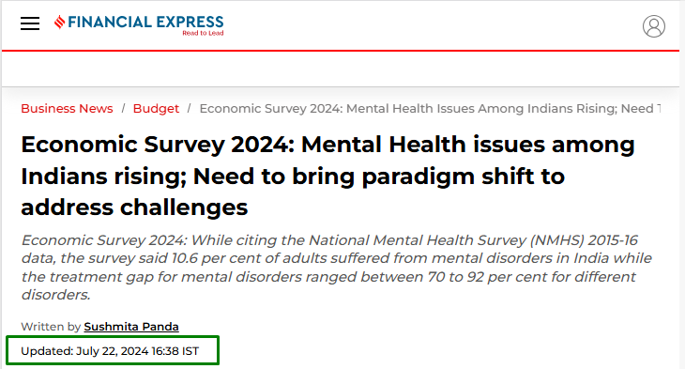

Slide 6
MENTRIX
Early Detection of Mental Health Issues
Improved Productivity and Engagement
Enhanced Employee Support
Data-Driven Decision-Making
Ethical and Confidential Analysis

Slide 7
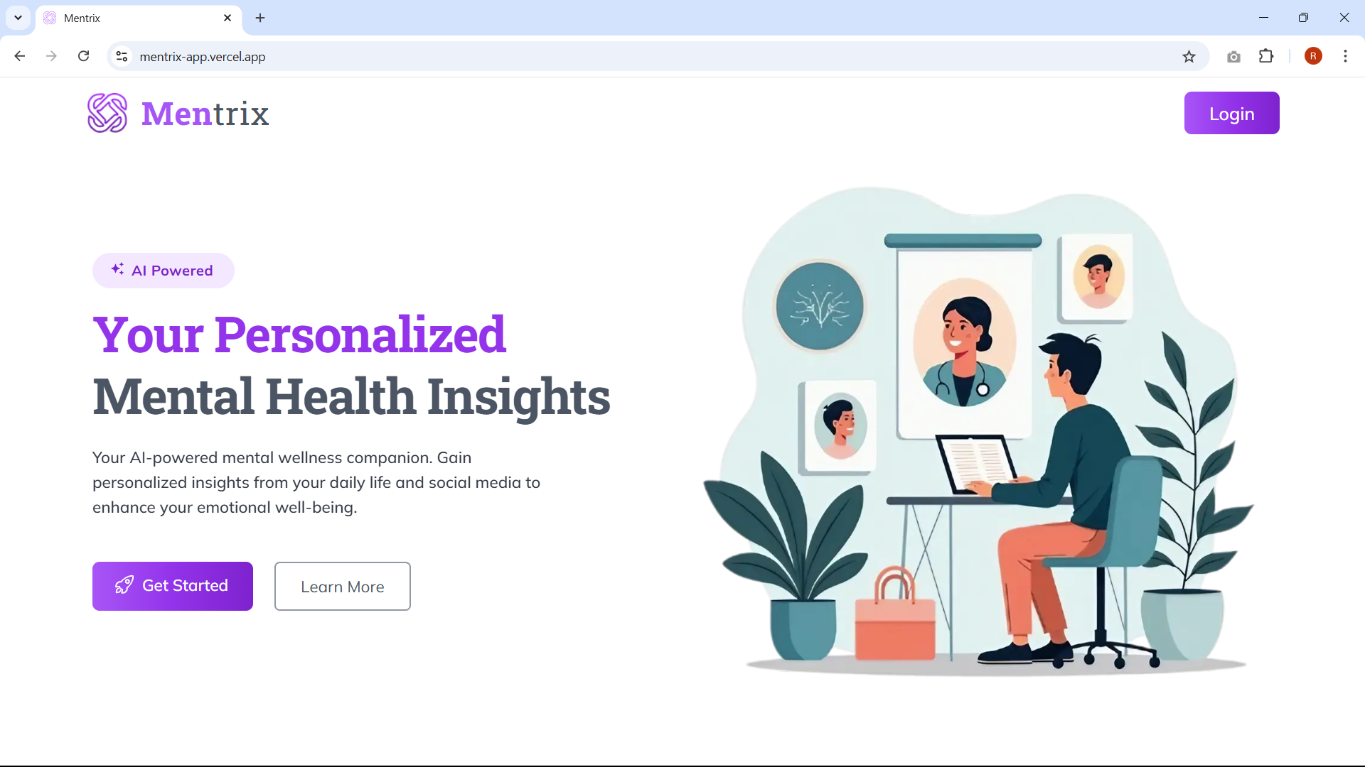




<< Our Core Technology Ecosystem >>
Flask
NextJs
TENSORFLOW

Slide 8
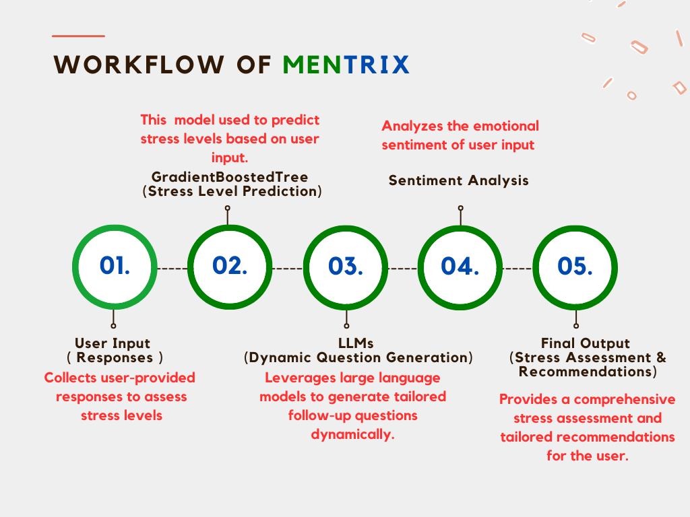

Slide 9
A User's Journey

Slide 10
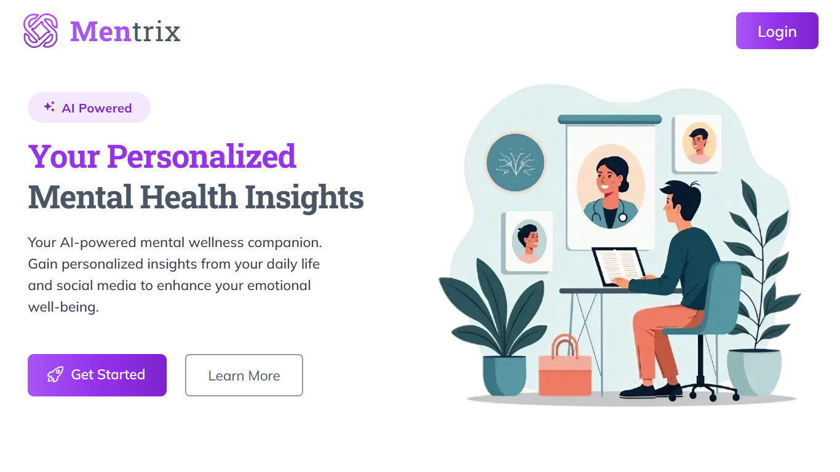

Slide 11
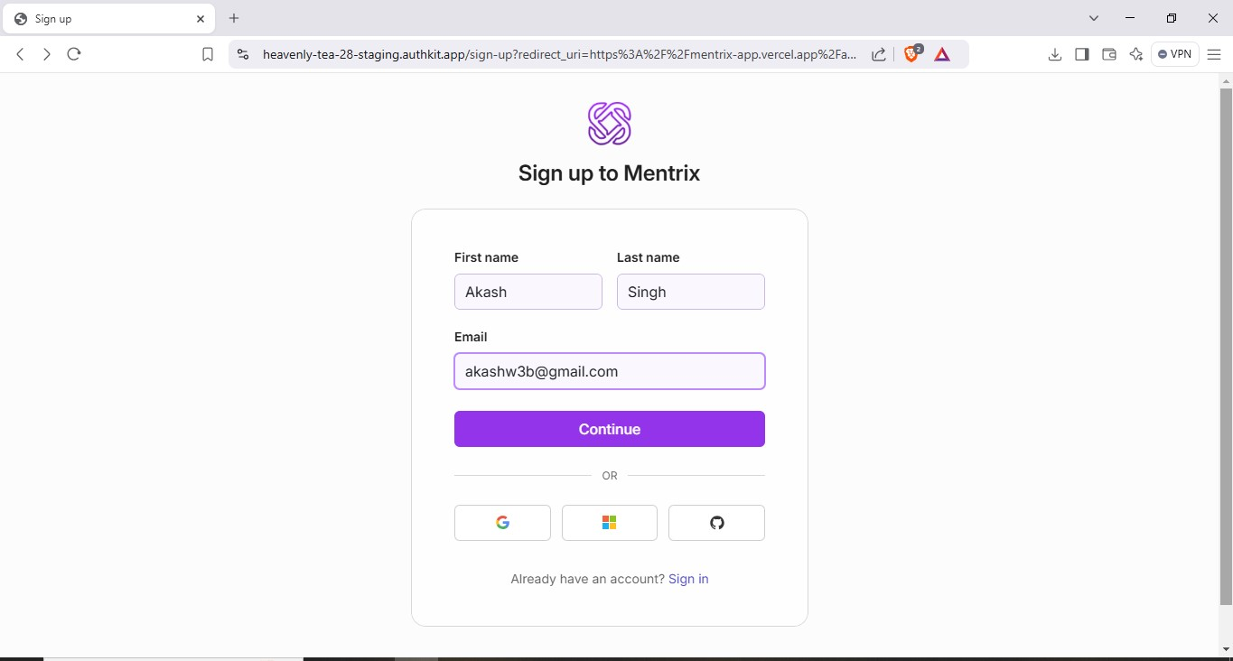

Slide 12
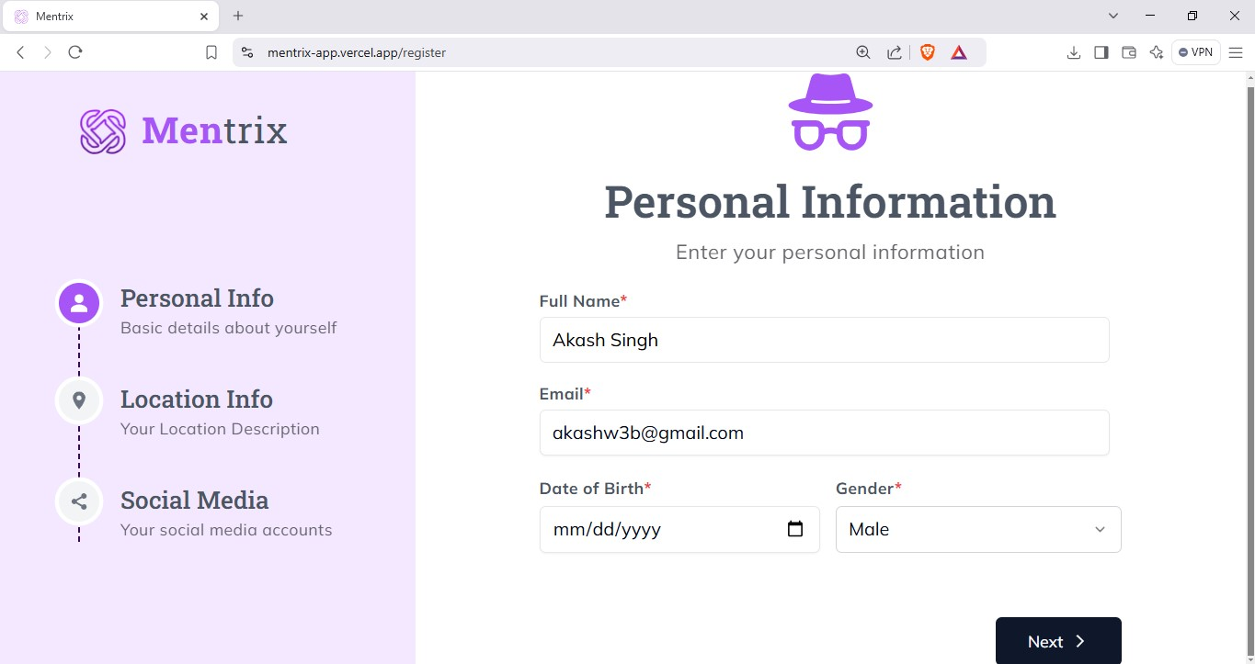

Slide 13
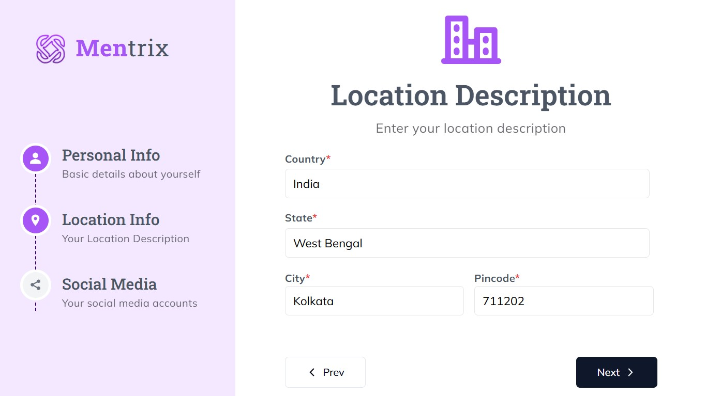

Slide 14
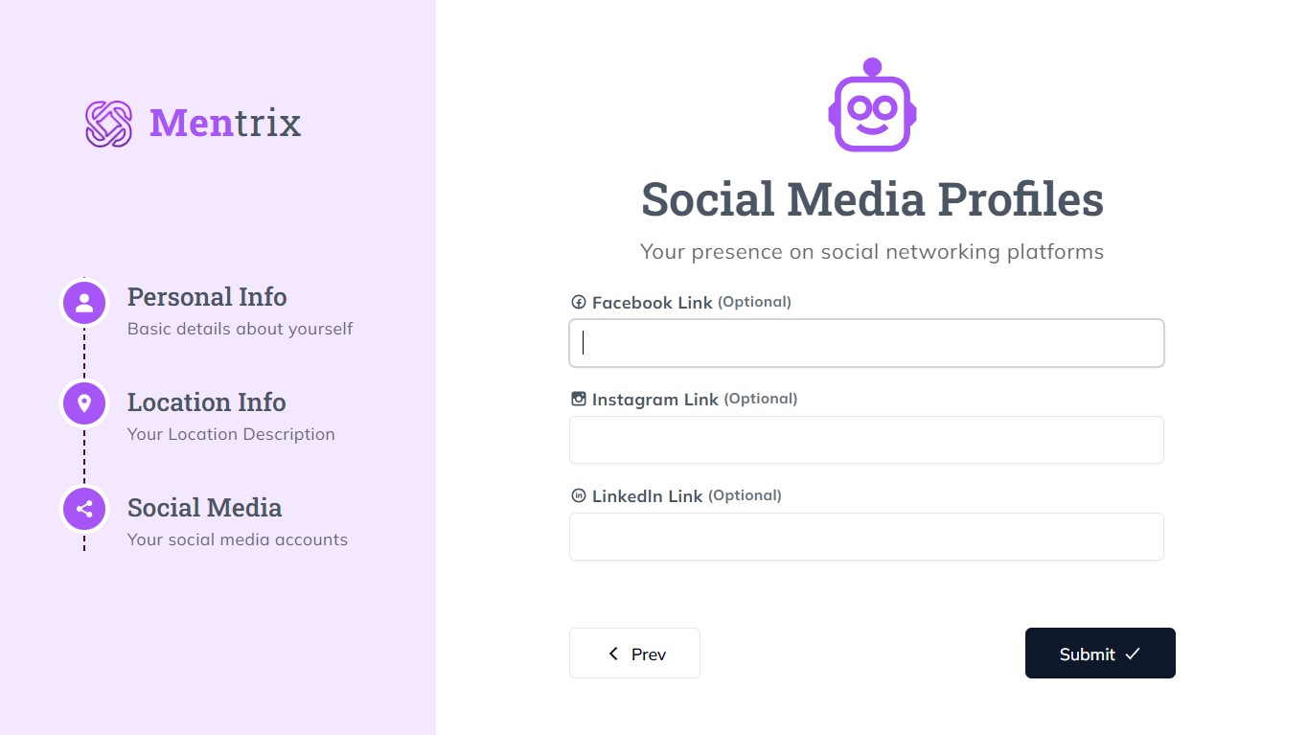

Slide 15
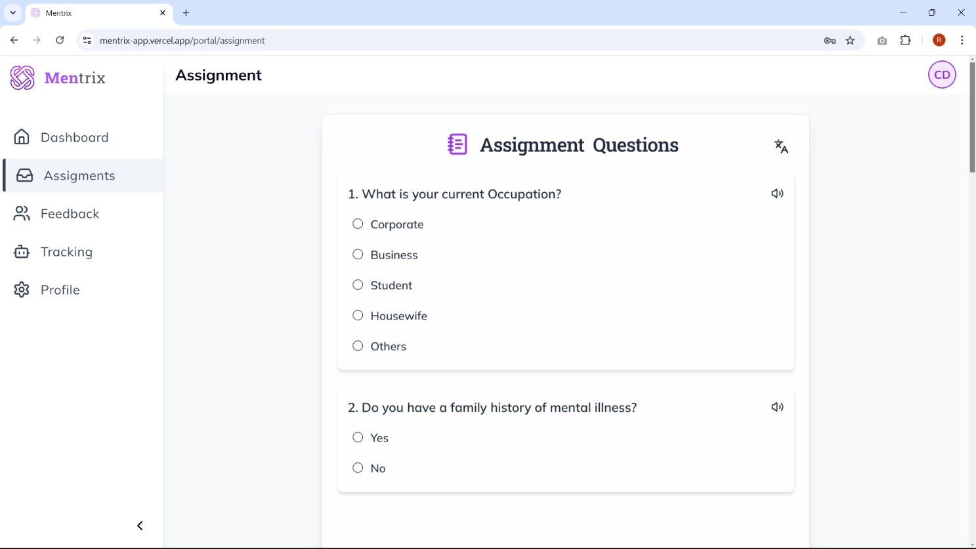

Slide 16
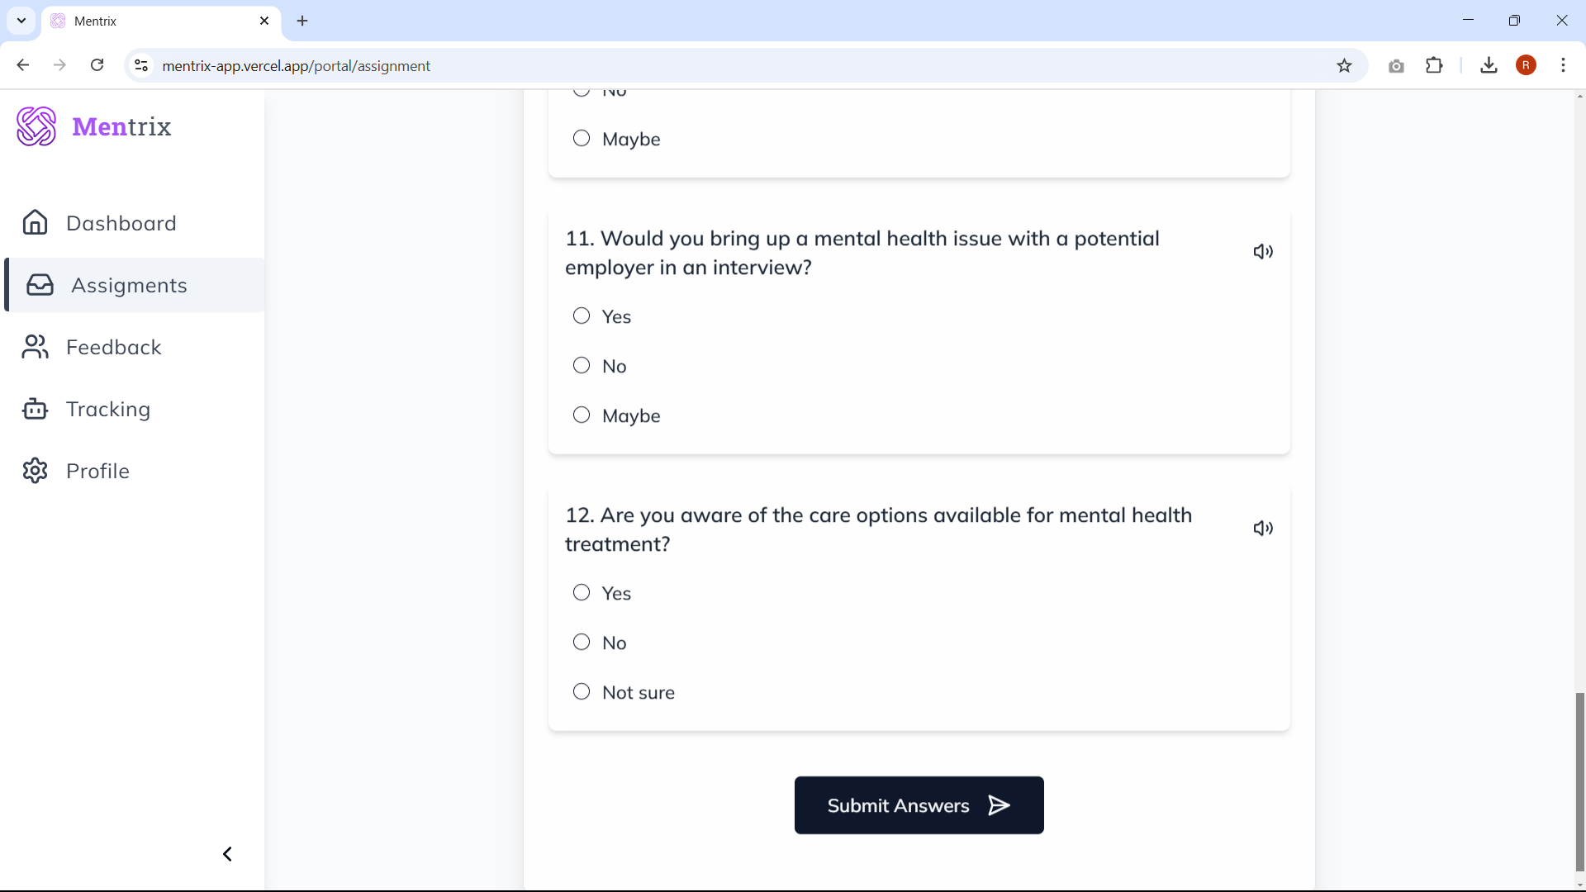

Slide 17
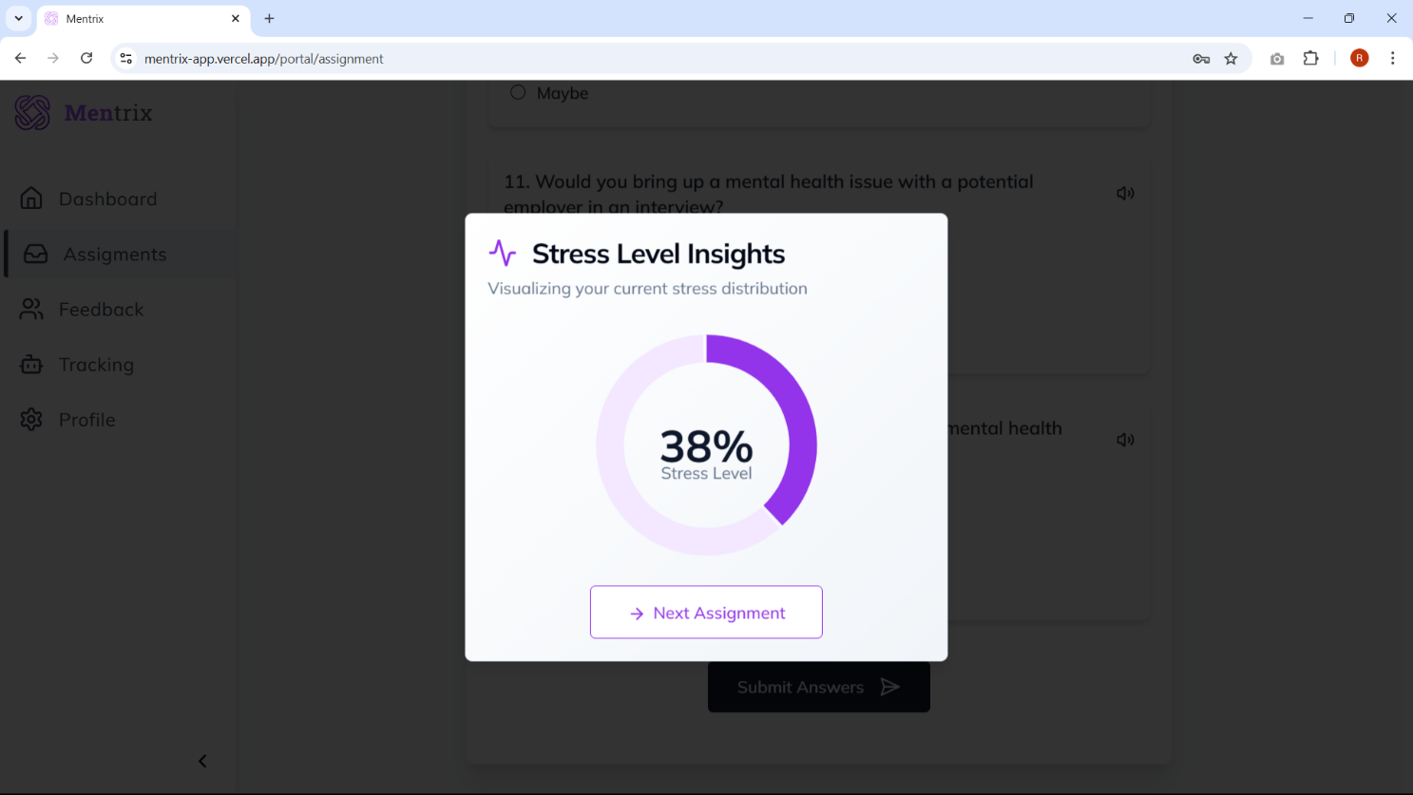

Slide 18
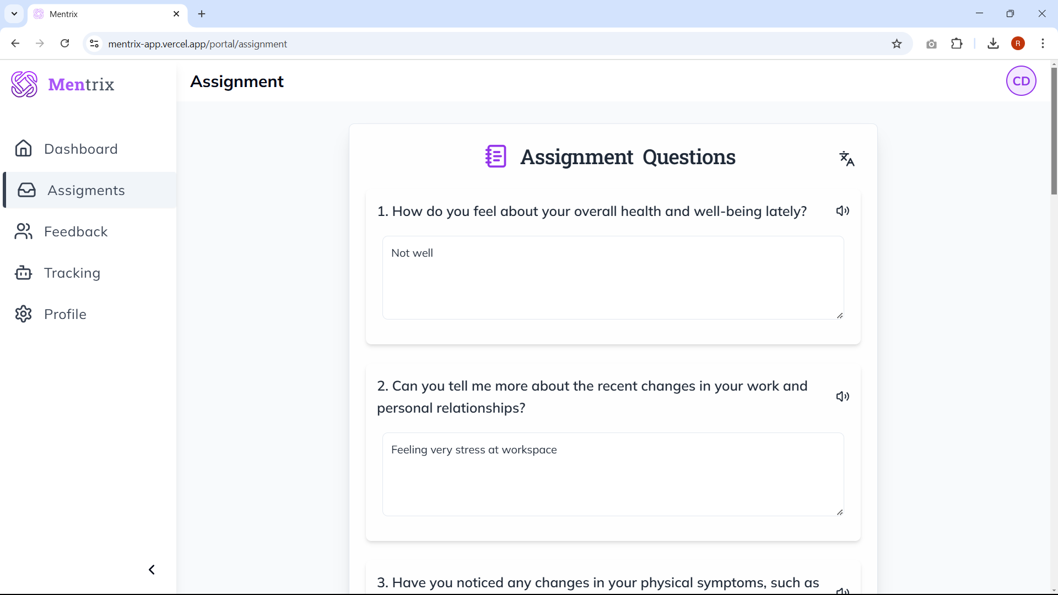

Slide 19
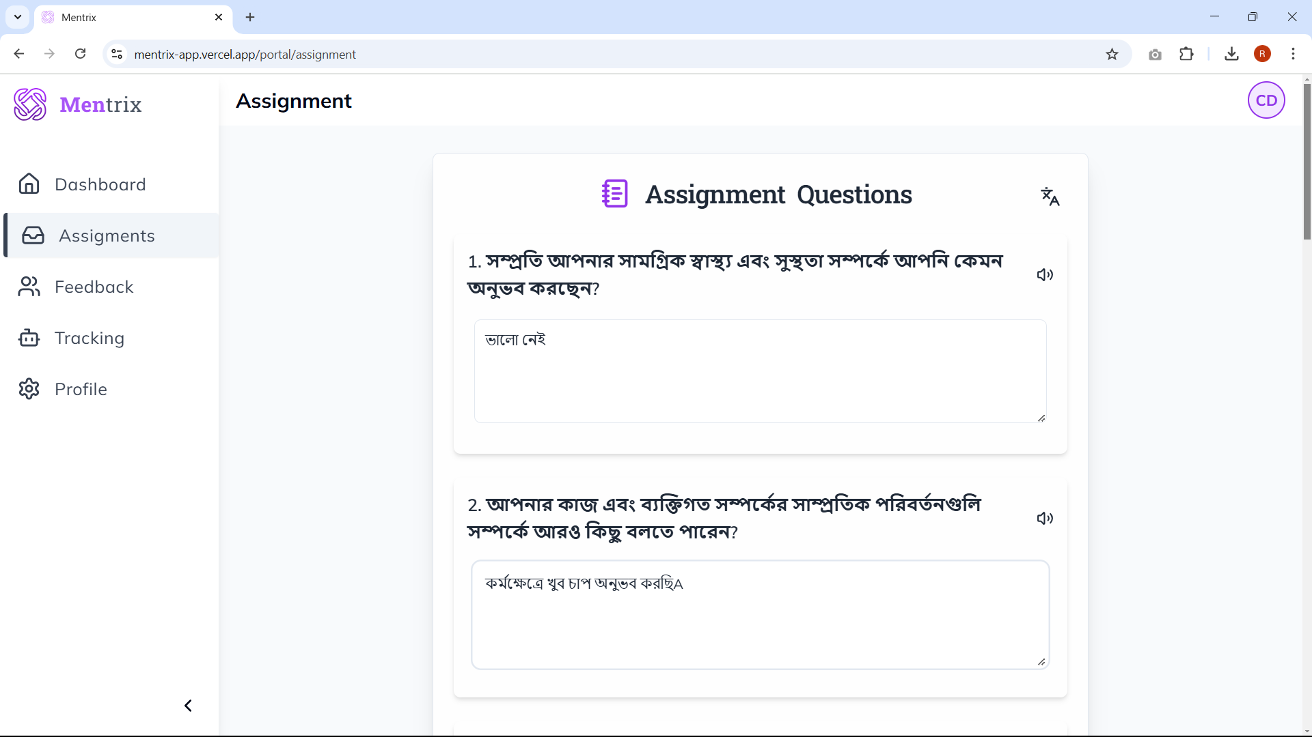

Slide 20
Example
Q) How do you feel about managing your work life and personal life? Ans) Not Balanced
I feel like my work and personal life are not perfectly balanced
Sentimental Analysis Model
Enhanced
2
Generated By LLM
Output
Ranges from 0 to 4 ( 0 is Normal … 4 Very High Stress)

Slide 21
Fine Tuning BERT for Mental Health Insights
Example Dataset
Text Preprocessing Tokenization
BERT Fine-Tuned for Mental Health Analysis
Concatenate
Interaction
layer
trouble sleeping,
confused mind,
restless heart.
All out of tune
Anxiety
restless
Anxiety
Linear layer
&
Activate Function
Been stuck in a loop of ruminating/ overthinking.
Depression
Overthinking
Pretrained
transformer
Depression
Trouble
Stress
Confused
Normal
If I fail, there is no more hope left for me, in this shitty life. it is going to be my 3rd attempt
Suicidal
Last Hidden Layer
https://www.kaggle.com/datasets/soumyajitmandal007/custom-dataset-for-mental-health
Actionable Insights for Intervention

Slide 22
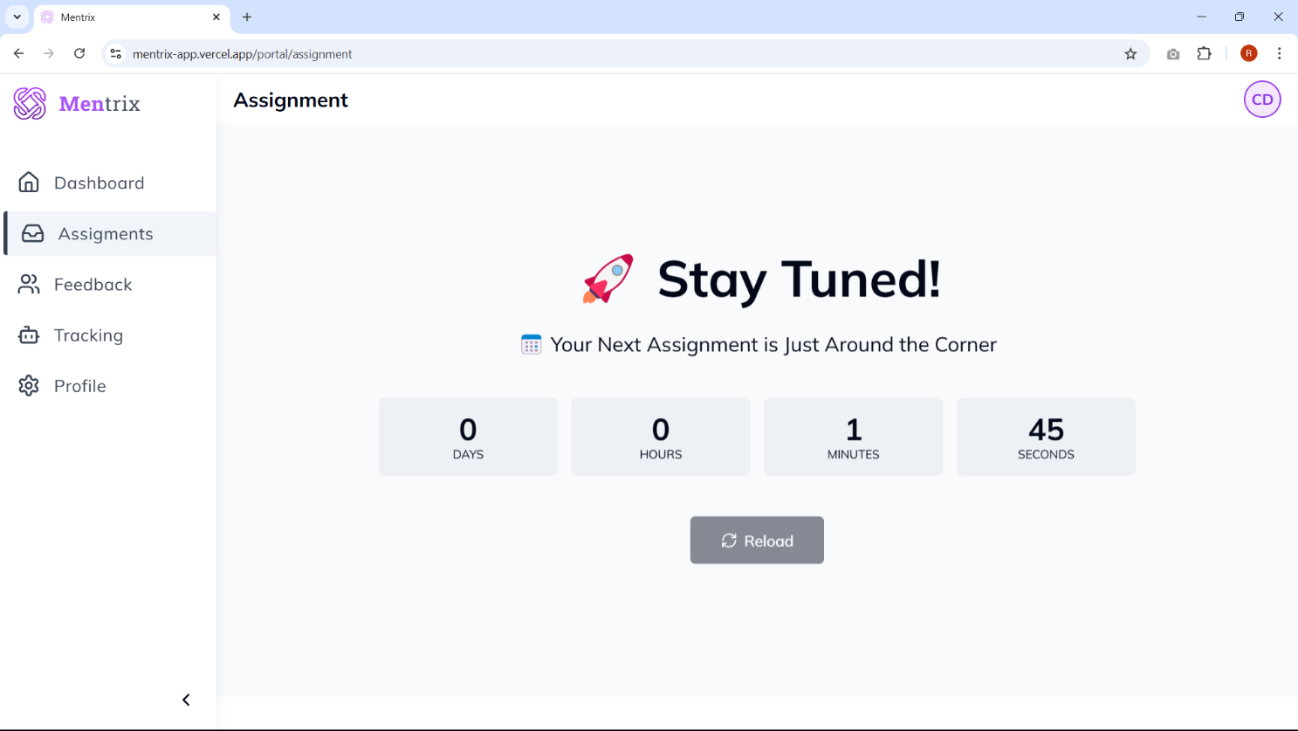

Slide 23
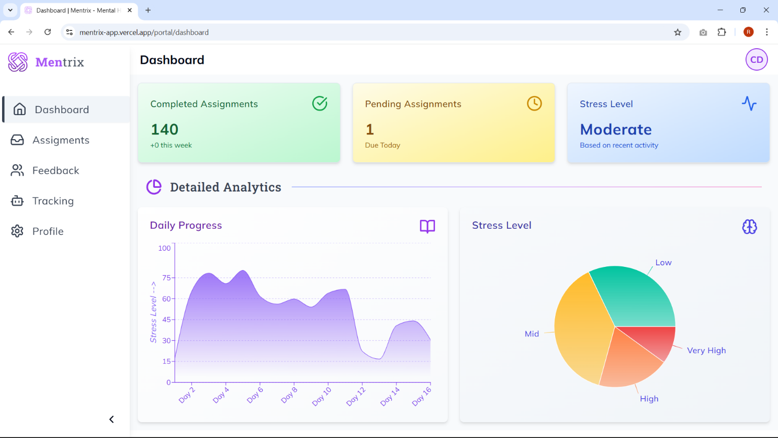

Slide 24
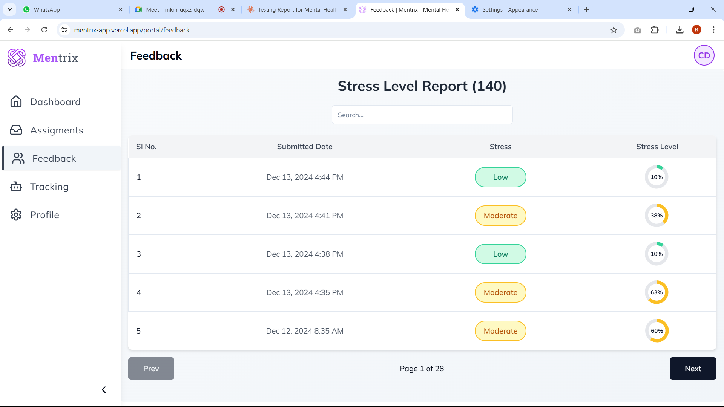

Slide 25
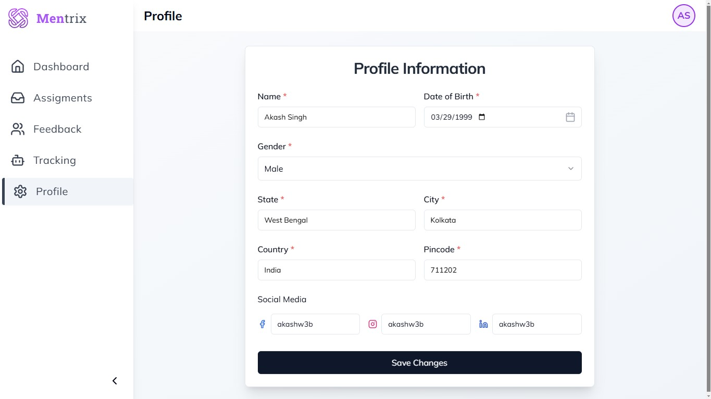

Slide 26
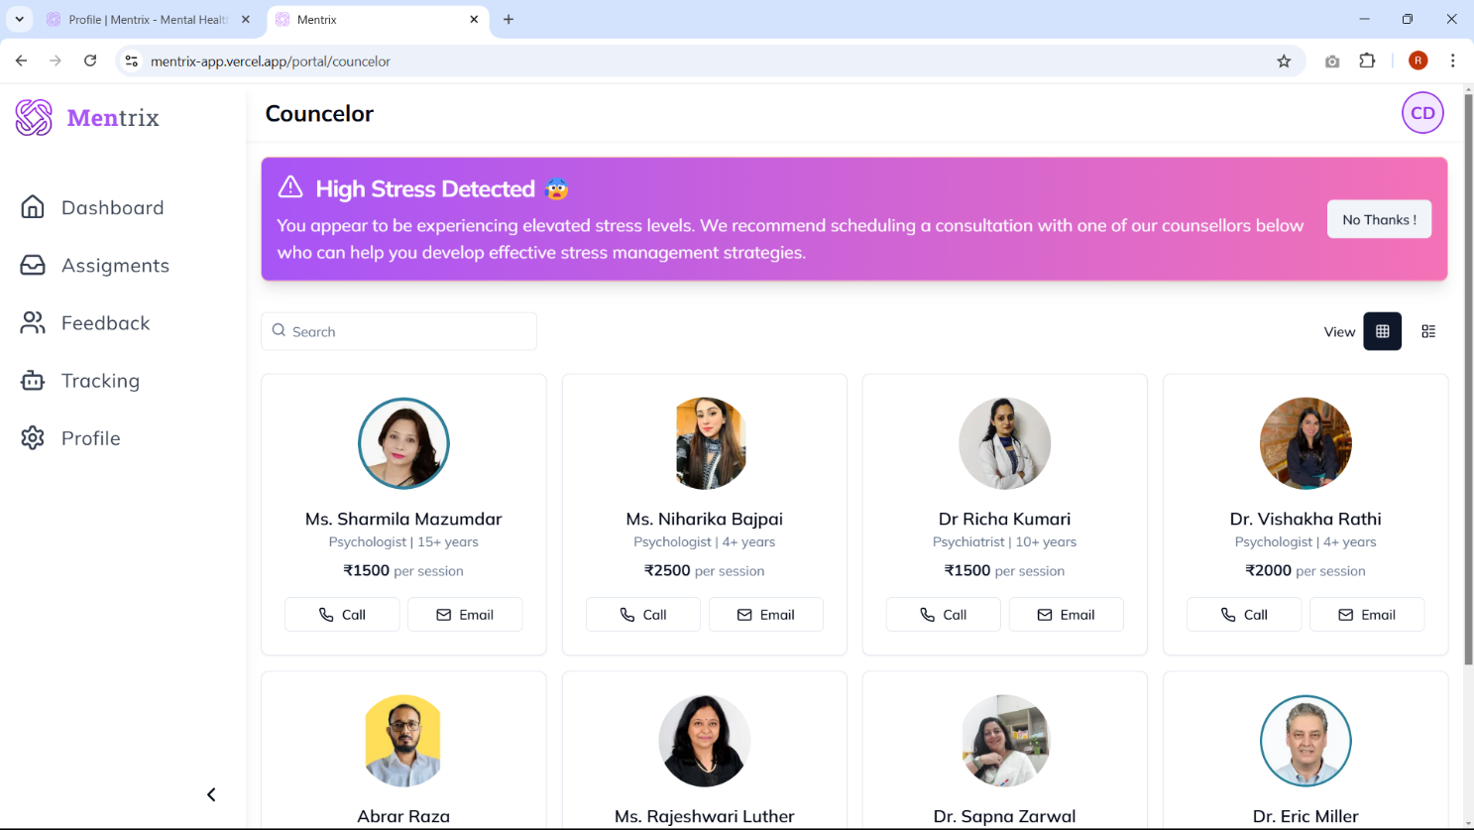

Slide 27
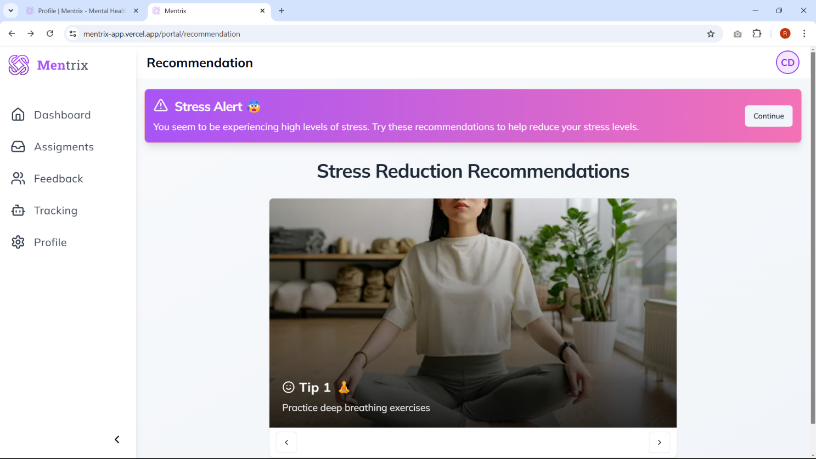

Slide 28
Who can use Mentrix ?
Human Resource Departments
Team Leaders and Managers
Corporate Organizations
Mental Health Professionals
Educational Institutions
Healthcare Organizations
Non-Profit Organizations

Slide 29
Future Scope
Facial Emotion Recognition:
Integrate computer vision techniques to analyze facial expressions ( smiles, frowns ) in real-time or from recorded video.
A model to recognize emotions like happiness, sadness, anger, and surprise, which can provide valuable insights into an employee's emotional state.
Voice Analysis:
Analyze vocal characteristics such as pitch, tone, and speech patterns. Develop models that can detect signs of stress, anxiety, or depression in an individual's voice.
Incorporate natural language understanding techniques to analyze the emotional content of speech.

Slide 30
References
Mikolov, T., Chen, K., Corrado, G., & Dean, J. (2013). "Efficient Estimation of Word Representations in Vector Space." arXiv Preprint arXiv:1301.3781.
Devlin, J., Chang, M.-W., Lee, K., & Toutanova, K. (2019). "BERT: Pre-training of Deep Bidirectional Transformers for Language Understanding." Proceedings of NAACL-HLT 2019.
Kaggle. Dataset."https://www.kaggle.com/datasets/iamsoumyajit/custom-extended-dataset-for-mental-health-analysis/data”
UCI Machine Learning Repository. "Mental Health Data." https://archive.ics.uci.edu/ml/
WHO Global Health Observatory. "Mental Health Data Resources." https://www.who.int/data/gho
Bishop, C. M. (2006). Pattern Recognition and Machine Learning. Springer.
Jurafsky, D., & Martin, J. H. (2021). Speech and Language Processing (3rd ed.). Pearson.
Russell, S. J., & Norvig, P. (2020). Artificial Intelligence: A Modern Approach
(4th ed.). Pearson

Slide 31

Thanks! ~ TEAM MENTRIX

